Slide 1
Mid-Term Presentation for B.Tech. Project (EEN-400B)
Performance Analysis of Multi-Pulse Converters
Guide: Dr Sumit Ghatak Choudhuri

Slide 2
Motivation
A Non-Linear Retrofit Load (such as induction motor drive) connected to the three-phase, AC mains, draws non-sinusoidal currents from the supply side.
This action pumps unwanted harmonics to the mains leading to effective fall in power factor at the supply side.
Use of Multi-Pulse converters (realised through an effective combination of uncontrolled converters with proper phase shift using phase-shifting transformers) is an intelligent, and robust solution for such cases wherein no strategic changes can be introduced into the existing Retrofit Non-Linear load.

Slide 3
Work Done
Study of Performance Characteristics of Phase Controlled Converters including:
Harmonic Analysis of dc terminal voltage and ac input current for general p-pulse converters^{[1]}
Transformer topologies delta/wye, delta/zigzag/fork^{[2]}
Interphase Reactors^{[2]}
Computation of Transformer and Interphase Reactor ratings^{[2]}
Pulse Doubling IPT Circuit^{[3]}
Simulation and comparison of 12-pulse D/y/d (with and without Pulse Doubling IPT) and Fork connected Uncontrolled Converters.

Slide 4
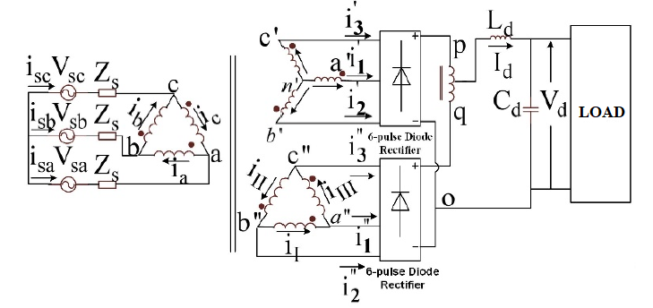
D/y/d winding
As the transformer has isolation, inter- converter currents are not possible. IPR connected between dc positive terminals of the converters neutralises instantaneous voltage difference between the two converters at the output port.

Slide 5
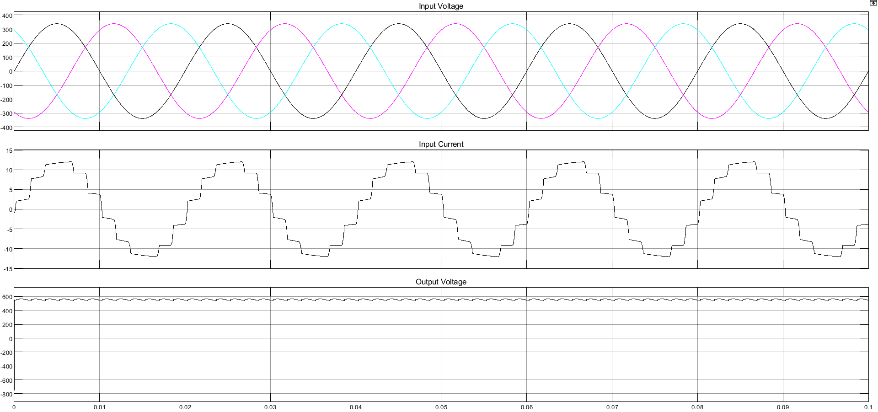
Matlab Results
THD = 11.81%
Total Magnetic Rating = 106.71% of load

Slide 6
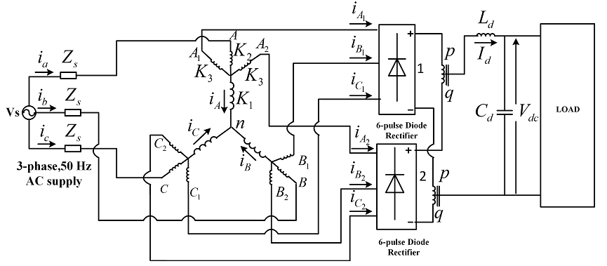
Fork Winding
As secondary windings are not isolated, there may be the possibility of inter converter current paths. To prevent such a situation, IPRs are connected in between respective positive terminals and in between respective negative terminals of the converters.

Slide 7
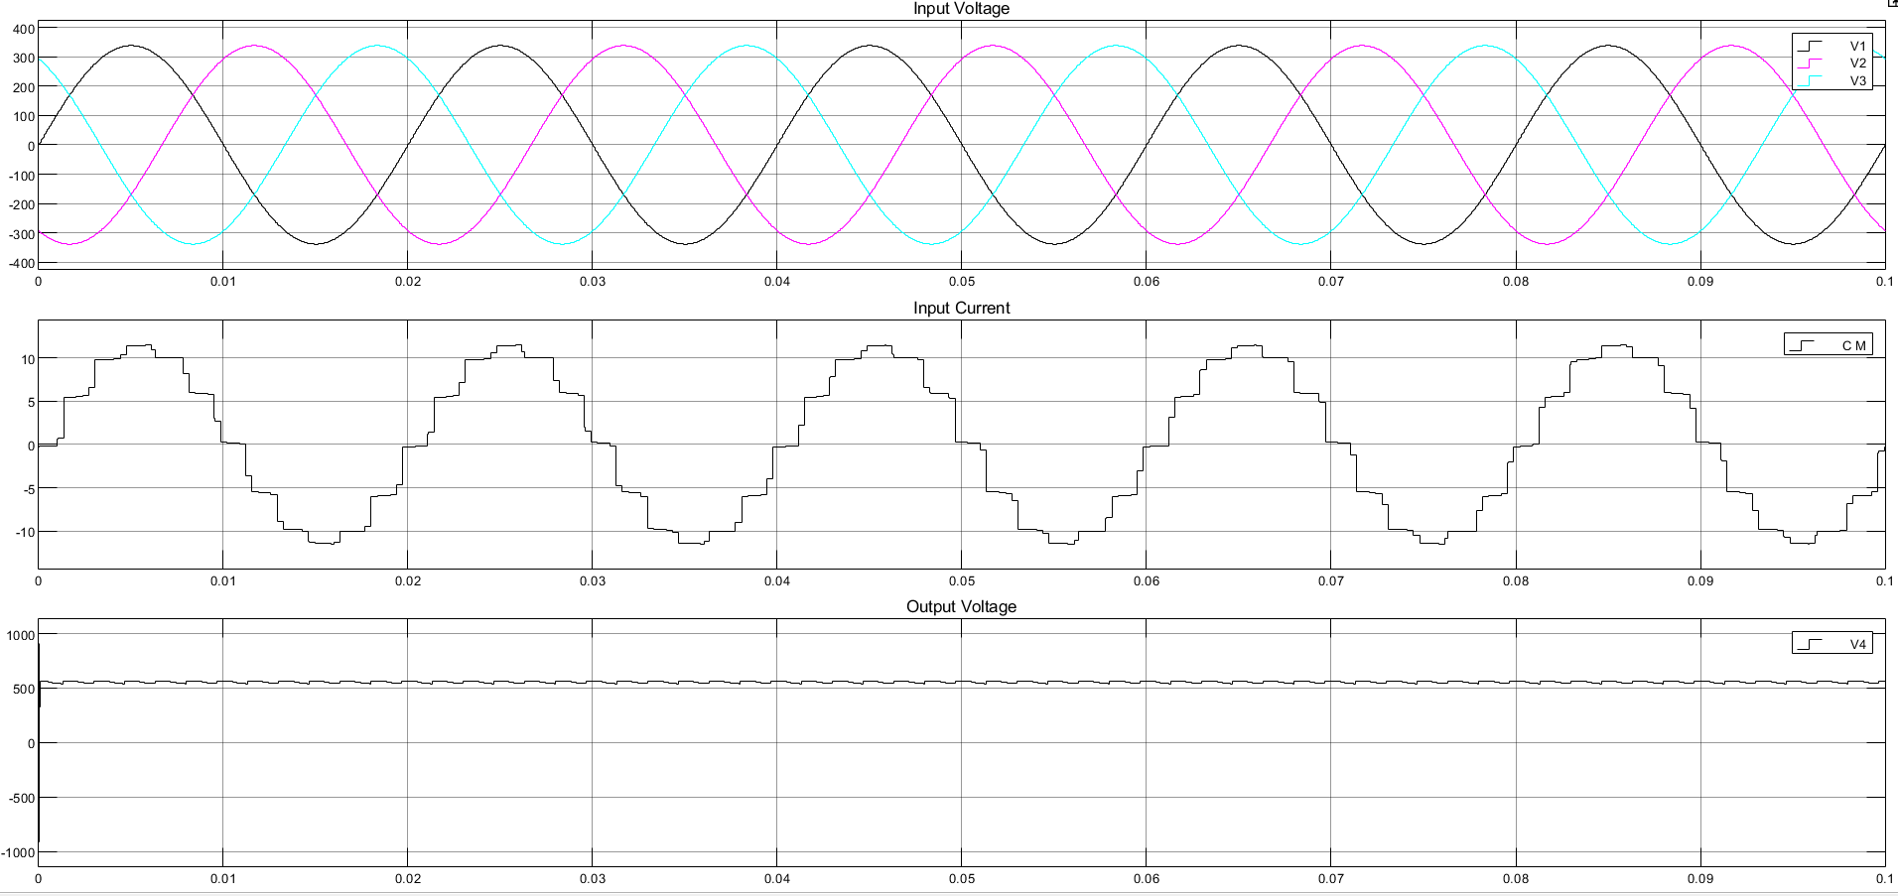
Matlab Results
THD = 11.23%
Total Magnetic Rating = 40.89% of load

Slide 8
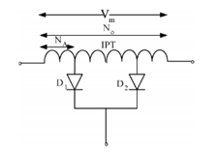
Pulse Doubling IPT
The turns ratio N_{A}/N_{O} is calculated from the Fourier analysis of input current I_{A} so as to give the desired input current characteristics. The 11th and 13 harmonics should be absent in input current, giving ratio:
k = N_{A}/N_{O} = 0.2457^{[3]}

Slide 9
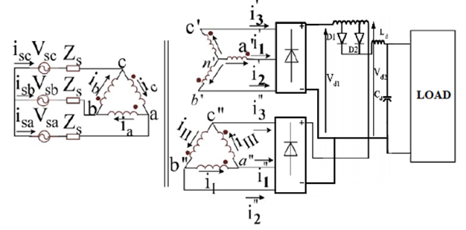
D/y/d with Pulse Doubling IPT
The pulse doubler IPT supports the voltage difference across the two rectifiers as well as ensures 24-pulse operation due to alternate conduction of diodes. Depending upon the rectifier with higher voltage, the corresponding diode gets forward biased.

Slide 10
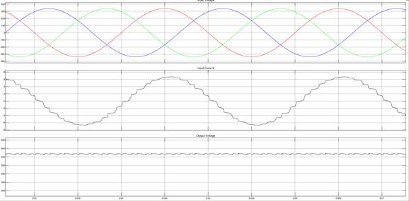
Matlab Results
THD = 4.829%
Total Magnetic Rating = 120.92% of load

Slide 11
Conclusion
 | D/y/d | D/y/d with Pulse Doubler | Fork
Power Transformer | 102.91% | 117.92% | 28.09%
IPR / Pulse Doubler | 3.80% | 3.07% | 12.81%
Total Magnetic Rating | 106.71% | 120.92% | 40.89%
THD | 11.81% | 4.83% | 11.23%
The comparison shows similar supply power quality aspects between D/y/d and Fork Topology. Therefore, the use of Fork topology saves copper and leads to a reduction in cost and improvement in power quality. Although by incorporating pulse doubler in the D/y/d transformer connection, the magnetic rating is slightly higher (120.9%), it brings down the THD significantly.

Slide 12
Work to be done:
Mathematical Analysis and MATLAB Simulations of various other transformer topologies, understanding the working of ZSBTs and comparisons of the same. VCIMD load is to designed and the validity of the topologies on retrofit load is to be tested.
References:
B. R. Pelly, “Thyristor Phase-Controlled Converters and Cycloconverters” New York: Wiley, 1971. Chapter 4.
Paice, D.A., “Power Electronic Converter Harmonic Multipulse Methods for Clean Power”; IEEE Press: New York, NY, USA, 1996. Chapters 1-4.
Choi, S.; Lee, B.; Enjeti, P. “New 24-pulse diode rectifier systems for utility interface of high-power AC motor drives.” IEEE Trans. Ind. Appl. 1997, 33, 531–541.

